Slide 1


Slide 2


An Overview
Our purpose…
We help organizations learn and adopt new technologies.
In 2018 alone...
…Impacts you daily.
When you talk on the phone, watch a movie, connect with friends on social media, drive a car, fly on a plane, pay with a credit card, shop online, and order a latte with your mobile app, you are interacting with technology developed by one of our customers.

Slide 3
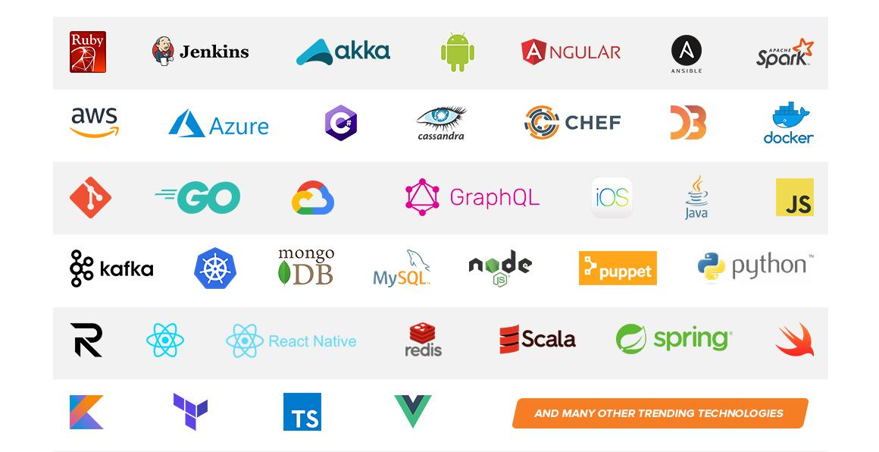
Technologies we cover

Slide 4
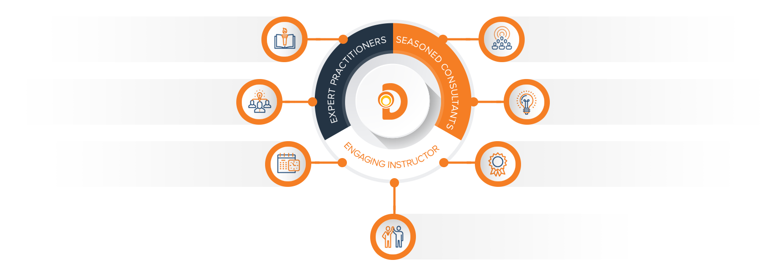
Our Practitioners
250 best selling
books authored
150 engagements speaking
at industry conferences
9+ years of training
experience
Over 17 years of industry
experience per instructor
750,000 practitioner led
training hours
125 certifications in leading
technologies
95% instructor satisfaction

Slide 5
Introduction to Terraform
(Just waiting for people to join after the town hall…)

Slide 6
Schedule
Course runs 9:00 - 3:30 Pacific time
Lunch break from 12-1 Pacific time
10-15 min. breaks as needed

Slide 7
Introductions: First You, Then Me
Name & Title
Job Role
Experience

Slide 8
Class Structure
Discussion
Exercises
Experiments

Slide 9
Discussion
Lecture-style presentation
Questions and thoughts are welcome at any time
Tangents are welcome as well–this part of the course should be interactive and stimulating

Slide 10
Exercises
Groups of 2-3 recommended
i.e., you are encouraged to work through things together, but may work individually if you wish
I’m here to help if you’re stuck or have questions

Slide 11
Experiments
an extension of exercises
we can take a closer look together as to how this applies to real scenarios in your current work
choose your own adventure or I can give some ideas to explore
uncovering Terraform “gotchas” and limitations
Anything spark ideas for you along the way that you’d like to see in action?
How can I help you get what you need to out of this course?

Slide 12
An Important Note
Terraform released version 0.12 in May 2019
some important foundational things changed with this release
we’ll be covering some syntax specific to 0.12 in this course
in general, the syntax and approaches throughout the course will make use of 0.12 capabilities.
Read more about 0.12 from Hashicorp:
https://github.com/hashicorp/terraform/releases/tag/v0.12.0
https://www.hashicorp.com/blog/announcing-terraform-0-12

Slide 13
Other Good Sources for Learning
Terraform has been around a while now, and is pretty popular, so there are plenty of other sources for learning
Hashicorp’s new learning portal: https://learn.hashicorp.com/terraform
Terraform repository for seeing the state of open issues: https://github.com/hashicorp/terraform/issues
Official Terraform docs: https://www.terraform.io/docs/index.html

Slide 14
What is Terraform?
“infrastructure as code”
declarative domain-specific language
what is declarative?
used to describe idempotent resource configurations, typically in cloud infrastructure
according to Hashicorp:
Terraform enables you to safely and predictably create, change, and improve infrastructure. It is an open source tool that codifies APIs into declarative configuration files that can be shared amongst team members, treated as code, edited, reviewed, and versioned

Slide 15
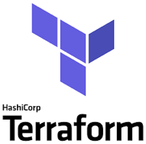
What is Terraform? (cont’d)
open source CLI tool for infrastructure automation
utilizes plugin architecture
extensible to any environment, tool, or framework and works primarily by making API calls to those environments, tools, or frameworks
detects implicit dependencies between resources and automatically creates a dependency graph
builds in dependency order and automatically performs activities in parallel where possible
...sequentially for dependent resources

Slide 16
Why Use Terraform?
readable
repeatable
certainty (i.e., no confusion about what will happen)
standardized environments
provision quickly
disaster recovery

Slide 17
What Does Terraform (HCL) Look Like?
resource “aws_instance” “web” {
ami = “ami-19827362728”
instance_type = “t2.micro”
tags = {
Name = “my-first-instance”
}
}

Slide 18
Exercise Prep: Let’s Get Set Up
We will create an isolated (and consistent) development and execution environment where you can run Terraform
You have been emailed your student alias, access key, secret key, and console password (check your Junk folder if you don’t have an email from me, and I can also send you the info via Zoom Chat)
Let’s get these working in your development environment–this will allow you to create things and verify they exist in AWS
Access to your instructional repository: Course Setup

Slide 19

Format of a Terraform Project
example-terraform-project
.terraform (more on this directory later)
main.tf
outputs.tf
variables.tf
terraform.tfvars
others.auto.tfvars
*.tf files get merged at runtime
terraform.tfvars and *.auto.tfvars files get merged at runtime

Slide 20
Hashicorp Configuration Language (HCL)
The goal of HCL is to build a structured configuration language that is both human and machine friendly for use with command-line tools, but specifically targeted towards DevOps tools, servers, etc.
Fully JSON compatible
Made up of stanzas or blocks, which roughly equate to JSON objects. Each stanza/block maps to an object type as defined by Terraform providers (we’ll talk more about providers later)
https://github.com/hashicorp/hcl

Slide 21
Terraform Project Content Types
*.tf, *.tf.json
HCL or JSON
these files define your declarative infrastructure and resources
*.tfstate
JSON files that store state, reference to resources
created and maintained by terraform
terraform.tfvars, terraform.tfvars.json and/or *.auto.tfvars, *.auto.tfvars.json
HCL or JSON
variable definitions in bulk
(more to come on setting variable values at runtime)

Slide 22
Resources
*.tf files contain your HCL declarative definitions
resource “aws_instance” “web” {
ami = “ami-19827362728”
instance_type = “t2.micro”
tags {
Name = “my-first-instance”
}
}
most blocks in your HCL represent a resource to be created/maintained by Terraform

Slide 23
Resources
resources are key elements and captured as top-level objects (stanzas) in Terraform configuration files
each resource stanza indicates the intent to idempotently create that resource
body of resource contains configuration of attributes of that resource
each provider (e.g., AWS, Azure, etc.) provides its own set of resources and defines the configuration attributes
when a resource is created by Terraform, it’s tracked in Terraform state
resources can refer to attributes of other resources, creating implicit dependencies
dependencies trigger sequential creation

Slide 24
Terraform Commands and the CLI
The CLI is how you’ll most often use terraform
terraform init …
terraform plan …
terraform apply …
And plenty more: terraform --help or https://www.terraform.io/docs/commands/index.html
Third-party SDKs also available for running and interacting with Terraform (e.g., scalr)

Slide 25
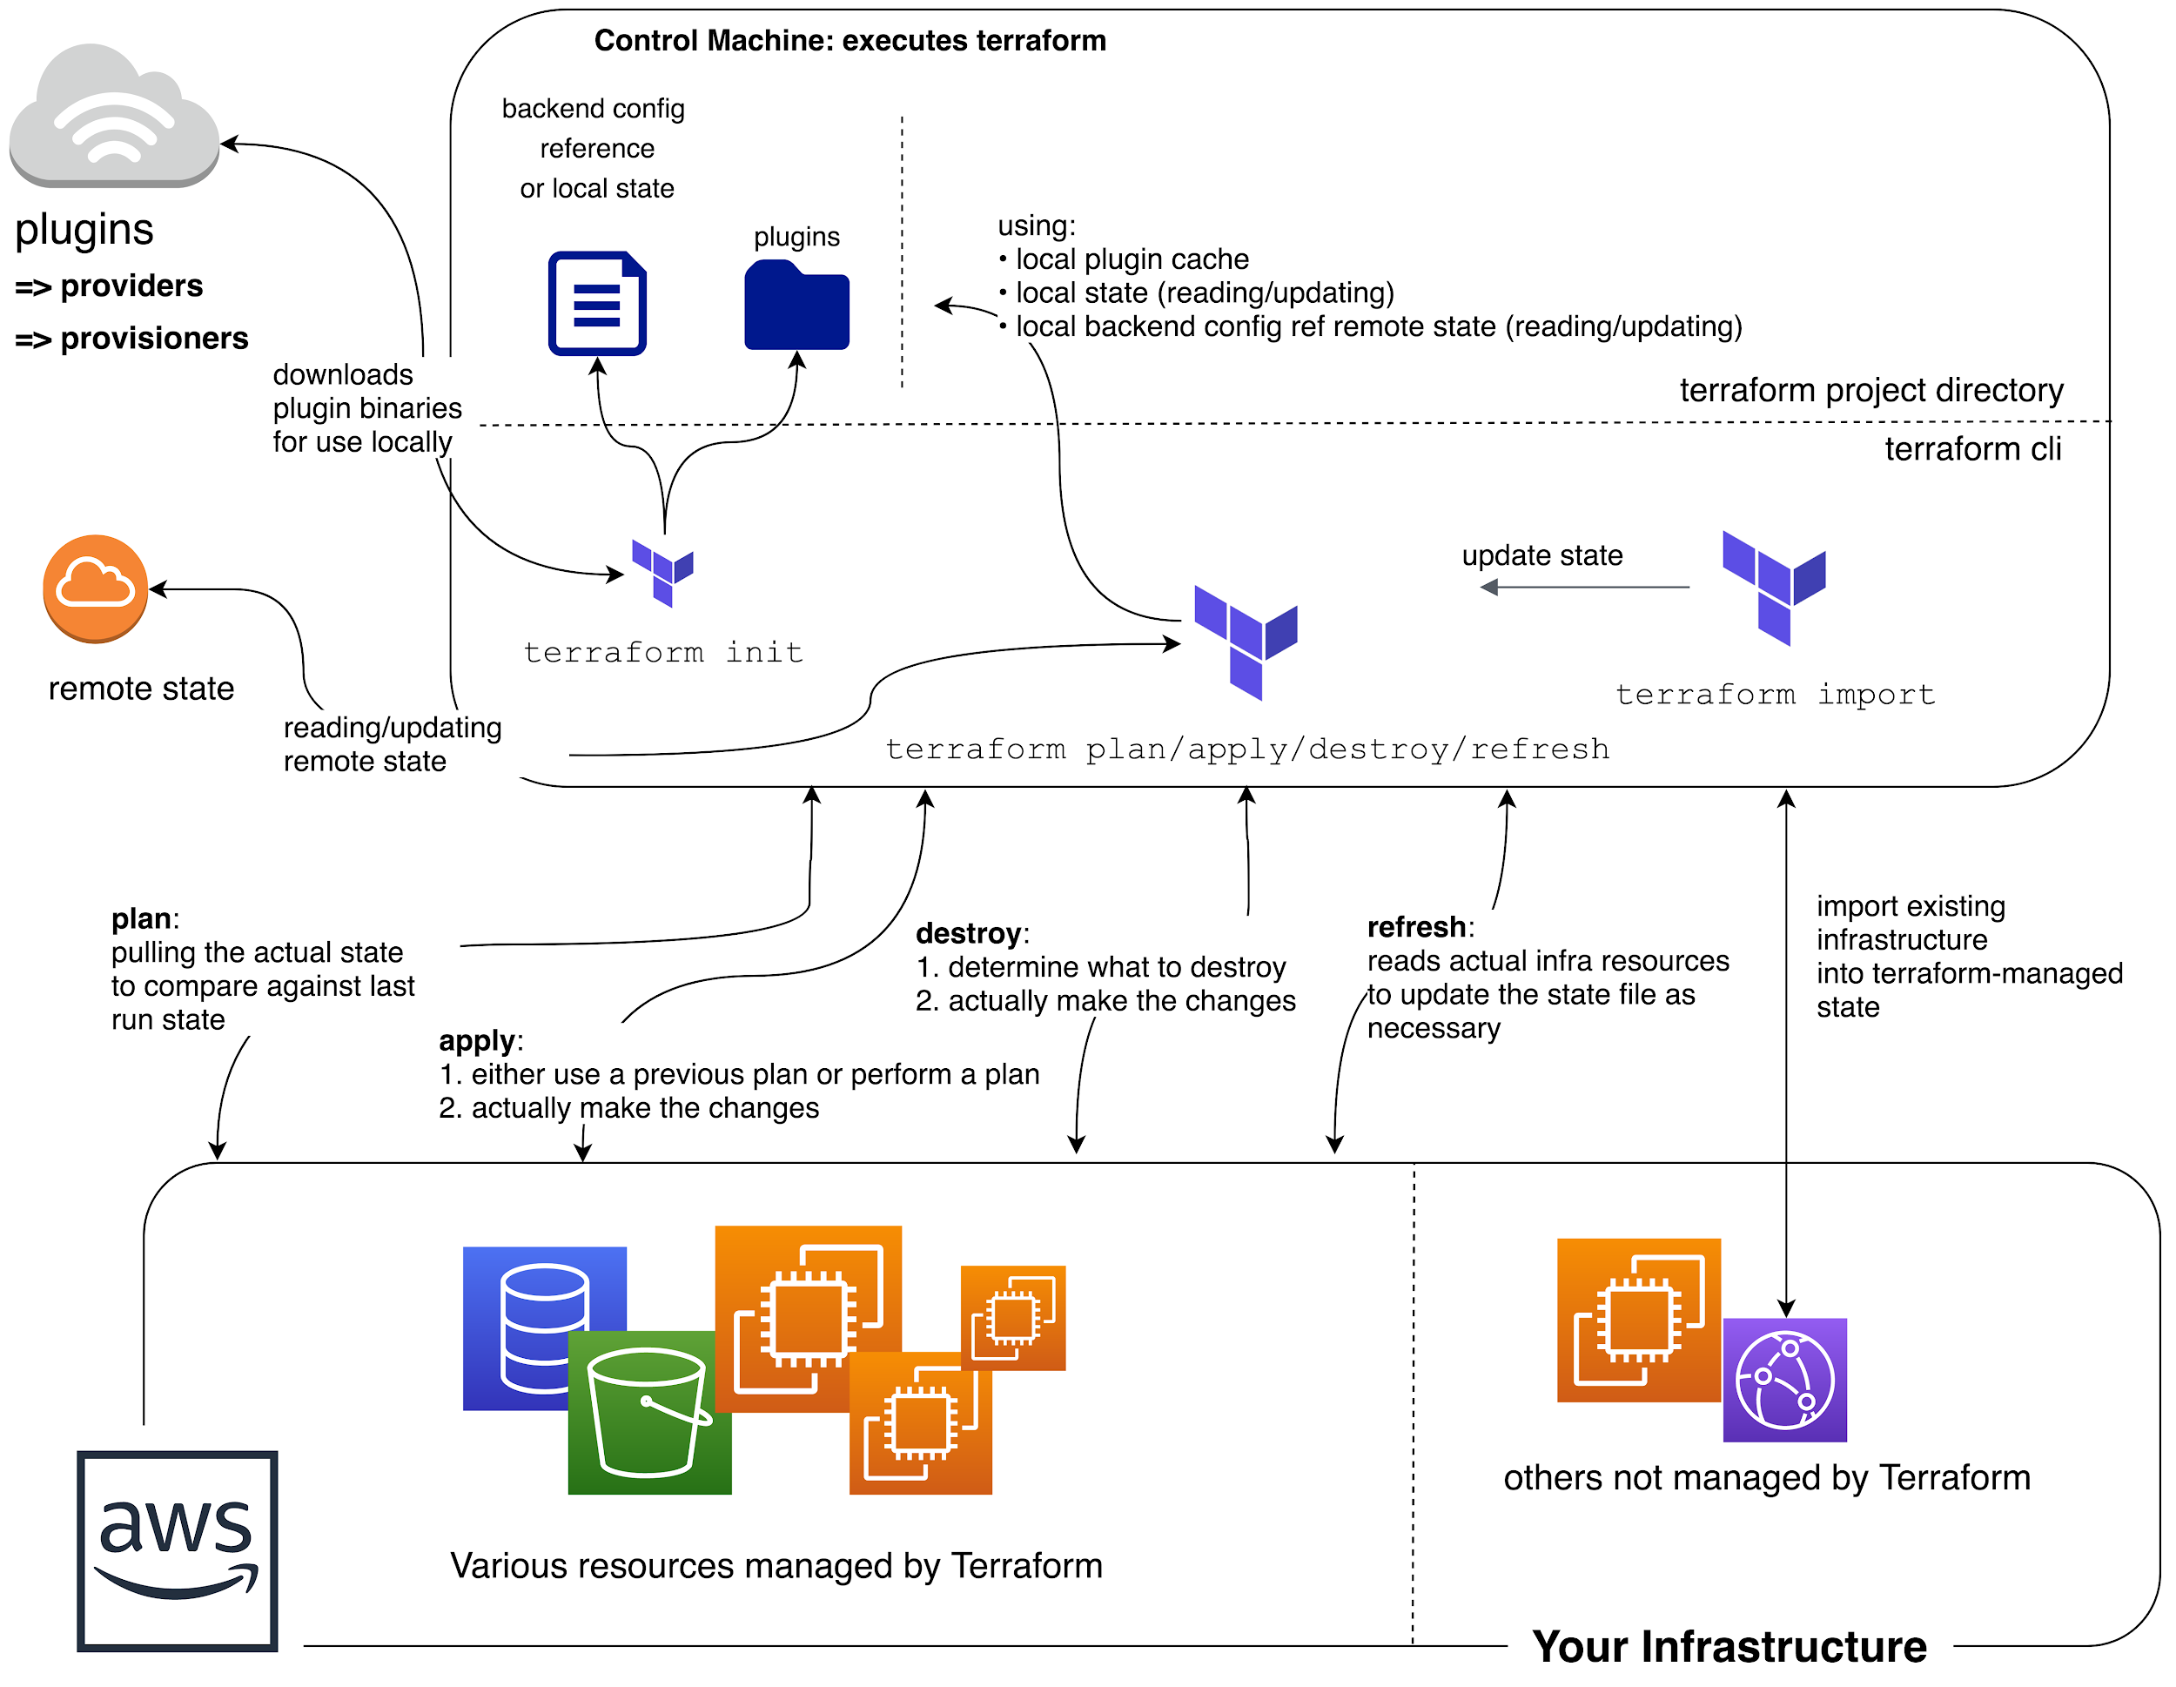
Big picture look at
Terraform Command Flow

Slide 26
terraform init
a special command, run before other commands/operations
what does it do?
downloads required provider packages
downloads modules referenced in the HCL (more on modules later)
initializes state
local state: ensuring local state file(s) exist
remote state: more complex initialization (more on remote state later)
basic syntax check
idempotent
remember the .terraform directory?
init downloads the provider packages and modules to this directory
also where state files live.

Slide 27
Exercise 1: First Terraform Project
Exercise 1

Slide 28
Extending Your Project
Input Variables
Locals
Data Sources
Provisioners
remote-exec
local-exec
null_resource

Slide 29
Input Variables
enable interchangeable values to be stored centrally and referenced single or multiple times
similar to variables in other languages
declared in variable stanzas
parsed first
cannot interpolate or reference other variables
allow for default values
optionally specify value type, e.g.,
List, Map, String

Slide 30
Example Variable Definition
variable “instance_size” {
default = “t2.micro”
type = string # changed in 0.12
description = “Size of EC2 instance”
}

Slide 31
Locals
mutable values that allow for interpolation and inference
CAN reference variables and other locals
CAN’T be set via arguments from the command line
use them when a value is used in many places in your code and that value is likely to change
don’t overuse them or your code can be difficult to read

Slide 32
Local Definitions
locals {
one = “1”
twelve = “${local.one}2”
onetwelve = “${local.one}${local.twelve}”
}

Slide 33
Data Sources
logical references to data objects stored externally to the tfstate file
allows you to reference resources not created by Terraform
examples
current default region in AWS CLI
AMI ID search
AWS ARN lookup
AWS VPC CIDR range
Notes:
AMI = Amazon Machine Image
ARN = Amazon Resource Name
CIDR = Classless Internet Domain Routing

Slide 34
Data Source Example: AWS AMI Lookup
data "aws_ami" "latest-ubuntu" {
most_recent = true
owners = ["099720109477"]
filter {
name = "name"
values = ["ubuntu/images/hvm-ssd/ubuntu-xenial-16.04-amd64-server-*"]
}
filter {
name = "virtualization-type"
values = ["hvm"]
}
}
Notes:
HVM = hardware virtual machine (cf. xen)

Slide 35
Provisioners
allow you to run commands during instance provisioning that are run on create, recreate, or taint correction (explained later), but not every time terraform apply is run
ties custom logic to idempotent resources
types
local
remote
chef
connectors
SSH
WinRM
Notes:
WinRM = Window Remote Management

Slide 36
Provisioner Example: local-exec
resource “aws_instance” “web” {
ami = “ami-19827362728”
instance_type = “t2.micro”
tags {
Name = “my-first-instance”
}
provisioner “local-exec” {
command = “echo ‘created instance’”
}
}

Slide 37
Provisioner Example: remote-exec
resource “aws_instance” “web” {
...
provisioner “remote-exec” {
inline = [
"sudo sed -i
's/^PasswordAuthentication.*/PasswordAuthentication yes/' /etc/ssh/sshd_config",
"sudo service sshd restart",
"wget https://repo.anaconda.com/Anaconda3-Linux-x86_64.sh",
"sh Anaconda3-Linux-x86_64.sh -b"
]
}
}

Slide 38
Provisioner example: null_resource
resource “null_resource” “first-tf-run” {
provisioner “local-exec” {
command = “echo ‘this will run on first tf apply’”
}
}
Notes:
Ask students–Why only on first run?

Slide 39
Exercise 2: Using Variables
Exercise 2

Slide 40
How Terraform Works
state and how to query it
computing plans
executing plans (terraform apply)

Slide 41
State
stores information about resources that are created by Terraform
also includes values computed by the provider APIs
local file
.tfstate
or backends are also available…

Slide 42
Backends
determines how state is loaded and how operations like apply are executed
enables non-local file state storage, remote execution, etc.
why use a backend?
can store their state remotely and protect it to prevent corruption
some backends, e.g., Terraform Cloud automatically store all revisions
keep sensitive information off local disk
remote operations
apply can take a LONG time for large infrastructures
Notes:
Swift = objecy/blob store

Slide 43
Backends (cont’d)
examples
S3
swift
http
Terraform Enterprise
etc.
Notes:
Swift = objecy/blob store

Slide 44
How to Query or See the Current State
CLI
terraform show [-json]
https://www.terraform.io/docs/commands/show.html
Remote State Data Type
https://www.terraform.io/docs/providers/terraform/d/remote_state.html

Slide 45
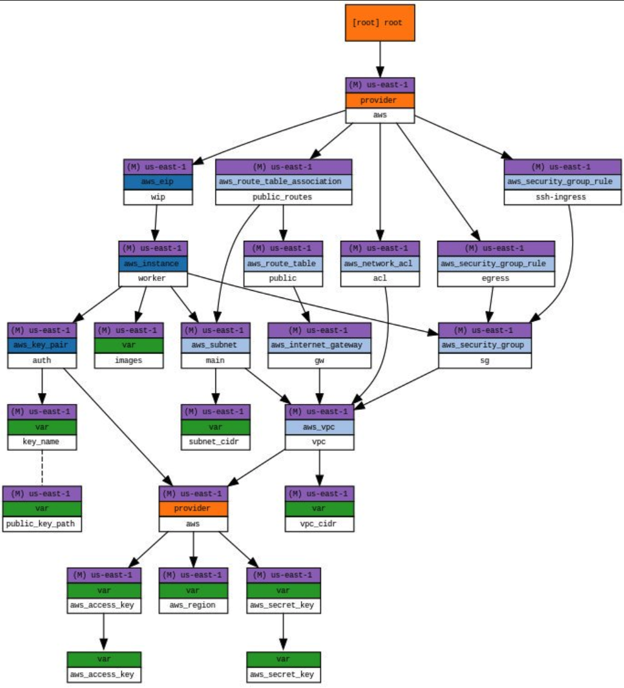
Visualizing Graph Outputs

Slide 46
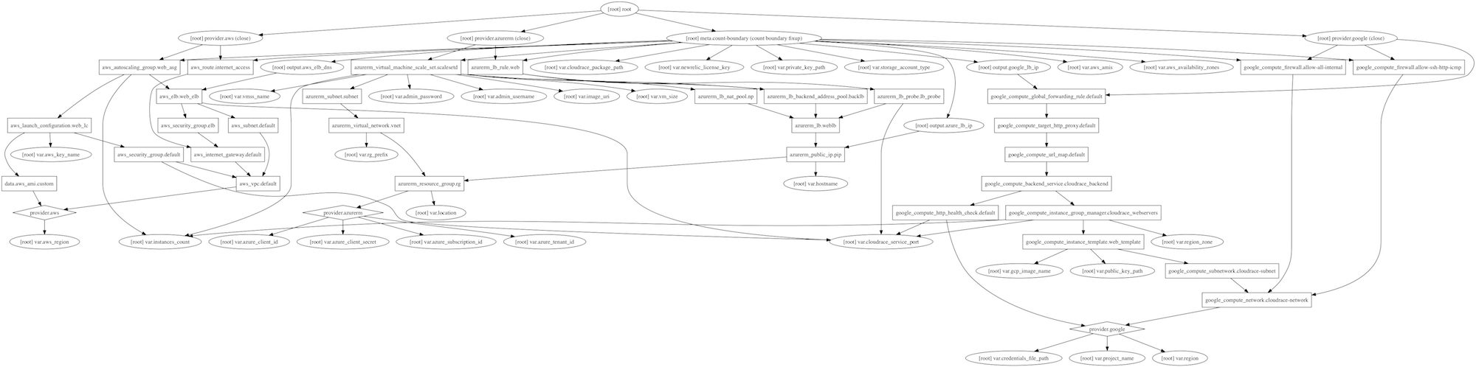
Visualizing Graph Outputs

Slide 47
Executing Plans: terraform apply
What does terraform apply do?
syntax check
check for init
refresh state
execute plan
ask for input
execute changes

Slide 48
Exercise 3: Plans and Applies
Exercise 3

Slide 49
Providers
responsible for understanding API interactions and exposing resources
Hashicorp helps companies create providers to be added to ecosystem
declared in HCL config files as a provider stanza
each Terraform project can have multiple providers, even of the same type
describes resources, their inputs, outputs, and the logic to create and change them
many options
AWS, GCP, Azure, and many many others
providers available for non-infra services as well such as gmail, MySQL, and Pagerduty

Slide 50
The AWS Provider
provider documentation
https://www.terraform.io/docs/providers/aws/index.html
HUGE amount of resources
something like 8 resources per service on average

Slide 51
Configuring the Provider
provider “aws” {
region = “us-west-1”
access_key = “[your access key]”
secret_key = “[your secret access key]”
}

Slide 52
Reuse Patterns in Terraform
Workspaces: separate state files for the same HCL
Outputs: automated use of terraform-managed resources
Modules: packaged HCL for reuse

Slide 53
Workspaces
Workspaces allow you to use the same configuration (HCL/project) for multiple states
example: AWS Developer VPCs–each developer could have an identical environment as defined by the configuration, but each managed by a different state by way of separate workspaces
nothing more than separately-named state files
both local and remote state backends support workspaces

Slide 54
Outputs
inputs to a Terraform config are declared with variables stanzas
outputs are declared with a special output stanza
can be referenced through the modules interface or the CLI

Slide 55
Output Definition
output “instance_public_ip” {
value = aws_instance.web.public_ip
}

Slide 56
Modules
modules are a critically important concept in Terraform
basically, every Terraform working directory, as long as it has variable stanzas, is a module
this allows developers to compose reusable blocks of configuration and reference them with module stanzas

Slide 57
Modules
allow for modularized configuration (create separate modules for different parts of configuration), aka module composition
every project has at least one module (the “root” module), but root can have a tree of children
child modules have input variables passed in from parent module
modules can be defined by configuration files in local filesystem or remote source

Slide 58
Modules
can publish modules in Terraform registry to make them easy to find
source attribute identifies location of module, e.g.,
most attributes of a module are input variables passed in from parent
module’s outputs can be accessed and used by parent (and passed to other child modules of the parent)
module “webserver” {
source = “./webserver” # module in this dir
instance_type = “t2.micro”
}

Slide 59

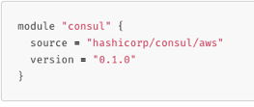
Module Sources
Terraform allows the user to pull modules from various locations
local paths
Github
Terraform Registry
Bitbucket
HTTP
S3 Buckets
More info
https://www.terraform.io/docs/modules/sources.html

Slide 60
Module Example
variable “thing” {
type = string
}
resource null_resource “null” {
provisioner local-exec {
command = "echo ${var.thing}"
}
}

Slide 61
Using the Module
module “my_module” “printer” {
source = “./my_module”
# this is a variable passed into module
thing = “this should be printed”
}

Slide 62
Exercise 4: Querying State
Exercise 4

Slide 63
Exercise 5: Interacting with Providers
Exercise 5

Slide 64
Exercise 6: Modules
Exercise 6

Slide 65
Experimentation Time: Webserver
Let’s first do this by hand, then use Terraform
Create an EC2 instance, type t2.micro, whatever distro you like
provision this instance to install nginx
make sure we can access nginx from the outside world
use online docs for help, use each other, and I’m here too if you need

Slide 66
Experimentation Time: Webserver (cont’d)
You can go in many different directions as you solve this, and there are plenty of things to play with along the way and after, some ideas:
imagine your Terraform code to spin up this instance needed to be reused, what are your options–make it reusable!
hints: workspaces, package as a module
pretend that some other automation needed the public IP from the created instance, how would you do this?
hints: outputs, and play with wrapping Terraform commands in a parent script (e.g., bash or Python)
...and finally, ANYTHING else you’d like to start learning more about, terraform graph maybe?

Slide 67
Introduction to Terraform
Welcome to Day 2!

Slide 68
Day 1 Recap and Review
Let’s discuss some takeaways from yesterday
What questions do you have after sleeping on it?
Corrections, omissions
OK, let’s get into it

Slide 69
Error Handling and Debugging
Most errors fall into one of four types
Process Errors
Syntax Errors
Validation Errors
Passthrough Errors

Slide 70
Process Errors
errors due to process not being followed
e.g.,
running apply before init
variables not fully populated

Slide 71
Syntax Errors
caused by an error in syntax, e.g.,
HCL codebase syntax or parameter errors
incorrect usage of built in functions
type errors

Slide 72
Validation Errors
preliminary validation built into provider occuring before plan
usually more detailed

Slide 73
Provider Errors / Passthrough
errors received from provider or third party API while in process of refresh, plan, apply, etc.
usually most difficult to troubleshoot
requires knowledge of provider’s tech (e.g., AWS)

Slide 74
Troubleshooting Commands
terraform validate
performs a syntax check on all terraform files in the directory
displays an error if any of the files doesn't validate
does NOT check formatting
what does it check…?

Slide 75
terraform validate
invalid HCL syntax (e.g., missing quote or equal sign)
invalid HCL references (e.g., variable name or attribute which doesn't exist)
same provider declared multiple times
same module declared multiple times
same resource declared multiple times
invalid module name
interpolation used in places where it's unsupported (e.g., variable, depends_on, module.source, provider)
missing value for a variable (none of -var foo=... flag, -var-file=foo.vars flag, TF_VAR_foo environment variable, terraform.tfvars, or default value in the configuration)
Notes:
depends_on = if Terraform must manage access control policies and take actions that require those policies to be present, there is a hidden dependency between the access policy and a resource whose creation depends on it. In these rare cases, the depends_on meta-argument can explicitly specify a dependency.

Slide 76
Troubleshooting: terraform fmt
rewrites Terraform files in a canonical format/style
by default, scans the current directory for configuration files
if the dir argument is provided then it will scan that given directory instead
if dir is a single dash (-) then fmt will read from standard input

Slide 77
Troubleshooting: terraform graph
generates a visual representation of either a configuration or execution plan
output is in DOT format, which can be used by GraphViz to generate charts: https://www.terraform.io/docs/internals/graph.html
e.g.,
terraform graph | dot -Tsvg > graph.svg

Slide 78
Troubleshooting: terraform console
creates an interactive console for testing interpolations
similar to running the Python interpreter in interactive mode
great for testing complex conditionals

Slide 79
Exercise 7: Error Handling, Troubleshooting
Exercise 7

Slide 80
Interpolation
embedded within strings in Terraform, whether you're using the HCL or JSON, you can interpolate other values.
These interpolations are wrapped in ${...}, such as ${var.foo}
allows you to reference variables, attributes of resources, call functions, etc.
simple math like
${count.index + 1}
allows for conditional statements
https://www.terraform.io/docs/configuration-0-11/interpolation.html

Slide 81
Built-in Functions
built-in functions:
Terraform ships with built-in functions
called with the syntax name(arg, arg2, ...)
e.g., to read a file:
${file("path.txt")}
https://www.terraform.io/docs/configuration-0-11/interpolation.html#built-in-functions

Slide 82
Conditionals
interpolations may contain conditionals to branch on the final value
syntax
CONDITION ? TRUEVAL : FALSEVAL

Slide 83
Primitive Data Types (new for v0.12!)
string
use the var prefix followed by the variable name
e.g., ${var.foo} is how you would use the variable in HCL for interpolation or reference
number
can be referenced as a number, so in arithmetic for example
${var.foo + 1}
bool
can be referenced as a boolean in logic, so something like
${var.foo == true ? “foo is true” : “foo is false”}

Slide 84
Extended Data Types (new for v0.12!)
list(<type>)
ordered list of things, i.e., array
e.g., ${var.subnets} would get the value of the subnets list
you can also return list elements by index: ${var.subnets[0]}
set(<type>)
similar to a list, but: requires a type, unique values, no ordering
map(<type>)
a collection of values where each is identified by a string
e.g., ${var.amis["us-east-1"]} would get the value of the us-east-1 key within the amis map variable

Slide 85
Extended Data Types (cont’d)
object({ <attr name> = <type>, … })
like many other language object types, with properties containing other values
tuple([<type>, …])
very similar to a list, mixed strictly defined typed list of things

Slide 86
Count Parameter
resources can be duplicated or conditionally created via the count parameter
resource “aws_instance” “web” {
count = 2
ami = “${var.ami}“
instance_type = “${var.instance_type}”
tags {
Name = “web-${count.index}”
}
}

Slide 87
Data Reference
attributes of current resource
syntax is self.ATTRIBUTE
e.g., ${self.private_ip} interpolates resource's private IP address

Slide 88
Data Reference (cont’d)
attributes of other resources
syntax is TYPE.NAME.ATTRIBUTE
${aws_instance.web.id}
interpolate ID attribute from the aws_instance resource web
if resource has a count attribute set, you can access individual attributes with a zero-based index, such as ${aws_instance.web.0.id}
or use the splat syntax to get a list of all the attributes: ${aws_instance.web.*.id}
UPDATE: 0.12 syntax for these is now:
${aws_instance.web[0].id}
${aws_instance.web[*].id}

Slide 89
Data Sources and Reference
attributes of a data source
data.TYPE.NAME.ATTRIBUTE
${data.aws_ami.ubuntu.id}
interpolate id attribute from the aws_ami data source ubuntu
if data source has a count attribute set, access individual attributes with a zero-based index, e.g., ${data.aws_subnet.example.0.cidr_block}
${data.aws_subnet.example[0].cidr_block} (0.12)
or use the splat syntax to get a list of all the attributes: ${data.aws_subnet.example.*.cidr_block}
${data.aws_subnet.example[*].cidr_block} (0.12)

Slide 90
Data Sources and Reference (cont’d)
Referencing values output from another module
module.MODULE_NAME.MODULE_OUTPUT_NAME

Slide 91
Resource Example w/Conditional
resource “aws_instance” “web” {
ami = “${var.ami}“
instance_type = “${var.instance_type}”
tags {
Name = “${var.env == “production” ? “production-web” : “staging-web” }”
}
}

Slide 92
Exercise 8: Understanding & Manipulating Data/Variables
Exercise 8

Slide 93
Keeping Terraform in Sync with Infra
configuration drift
things change!
Terraform can bring those things back in line naturally
plan
when executing a plan, Terraform can output machine readable syntax (exit codes) that can be used to monitor for manual infra changes
if the infra changes, plans will suddenly detect drift and inform alarms
apply
thanks to Terraform’s idempotency, corrections are natural and easy
Notes:
-detailed-exitcode

Slide 94
Keeping Terraform in Sync with Infra
what if we want to keep the changes?
you can import them
use terraform import to pull in the changes to the state
must also change the Terraform config to match any changes
if you have a clean plan with no planned changes, you were successful
e.g.,
terraform import aws_instance.my_instance i-abcd1234

Slide 95
Big picture look at
Terraform Command Flow

Slide 96
Exercise 9: Resource Counts and Conditionals
Exercise 9

Slide 97
Terraform Expressions
can set attributes, outputs and locals to expressions
expressions can refer to
literal values or complex literal values: true, 13,“us-west1”,[1, 2],{a:1, b:2}
resource or data source attributes: <RESOURCE TYPE>.<NAME>, data.<DATA TYPE>.<NAME>
type indices: local.list[3], local.object.attrname, local.map["keyname"]
variables: var.<NAME>
locals: local.<NAME>
…

Slide 98
Terraform Expressions (cont’d)
module outputs: module.<MODULE NAME>.<OUTPUT NAME>
path variables: path.module, path.root, path.cwd
workspace setting: terraform.workspace
built-in functions using any of the above as arguments
max(5, 12, var.my_value)
arithmetic, logical, or comparison operators combining the above
conditional expressions: var.a != "" ? var.a : “default-a”
string template interpolation: “Hello, ${var.name}!”
string template directives (new in v0.12):
"Hello, %{ if var.name != "" }${var.name}%{ else }unnamed%{ endif }!"

Slide 99
Terraform Expressions (cont’d)
Multi-line string templates (“heredoc” syntax, new in v0.12)
Looping string directive (for/endfor, new in v0.12)
<<EOT
%{ for ip in aws_instance.example.*.private_ip }
server ${ip}
%{ endfor }
EOT

Slide 100



Terraform Expressions
Splat syntax (v0.12 at top, v0.11 below)

Slide 101





Terraform Expressions
for expressions to convert lists/maps/tuples/objects to other lists/maps/tubles/objects (new in v0.12)

Slide 102
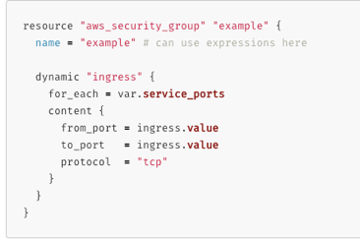
Terraform Expressions
dynamic blocks (new in v0.12)

Slide 103
Terraform Meta-arguments
resources, data sources, modules, and outputs can have meta-arguments (available across all types of all providers)
modules have: source, version, providers
outputs have: depends_on
resources have: depends_on, count, for_each (new in v0.12), provider, lifecycle, provisioner (provisioner can have connection inside)
data sources have same as resources except for lifecycle
depends_on forces a dependency on another object even if no implicit dependency by referring to an attribute of another object
lifecycle controls how resources are modified when configuration changes
for_each is like count except it iterates over a set (unordered list) or map, has each.key, each.value instead of count.index to refer to each index

Slide 104
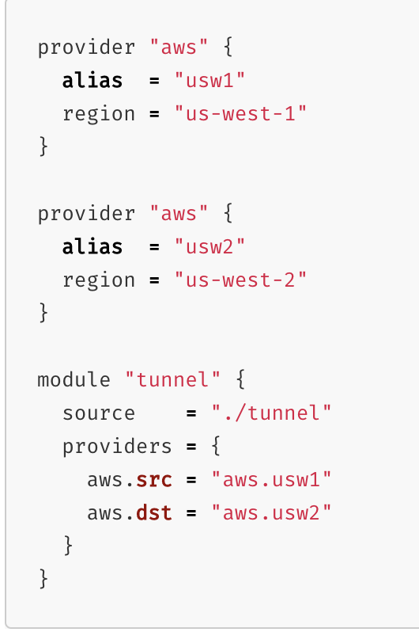
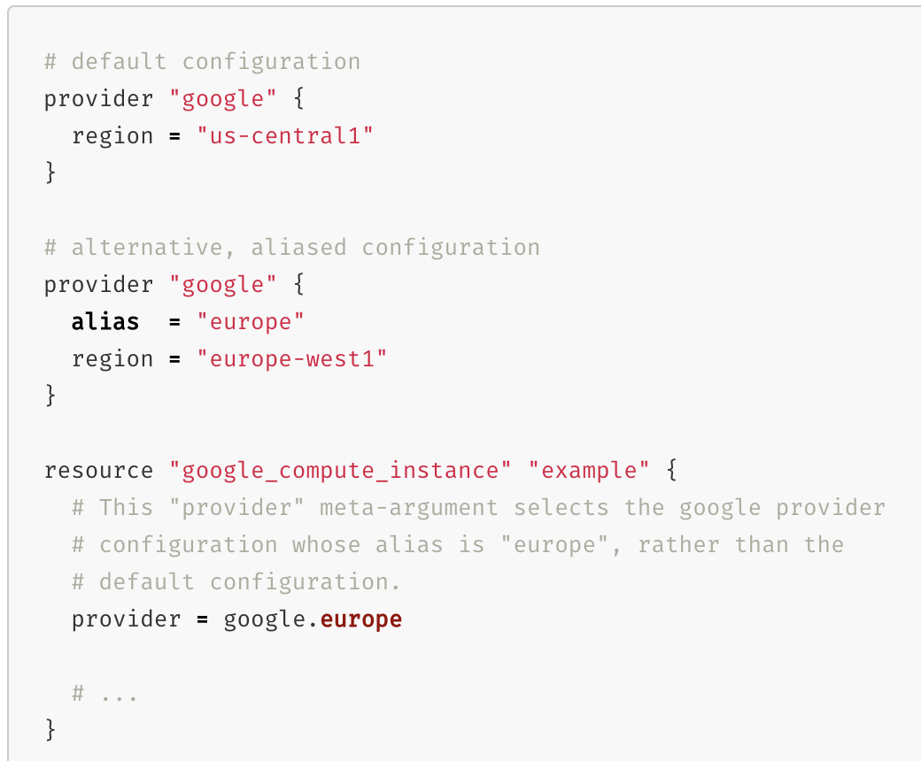
Terraform Meta-arguments
providers and provider are used when dealing with multiple providers in the same configuration

Slide 105
Upgrading from v0.11 to v0.12
Full details at: https://www.terraform.io/upgrade-guides/0-12.html
Upgrade to v0.11.14 first and run terraform init, terraform apply, and terraform 0.12checklist (this command makes suggestions for things to change before running automated upgrade command)
If the output of terraform 0.12checklist suggests some updates, complete them and rerun it and verify no other tasks are suggested
Then run the automated terraform 0.12upgrade command, then check automatically updated files for TF-UPGRADE-TODO markers/comments and make required changes
Rerun terraform plan and verify no changes are required

Slide 106
Backends
Backends are the concept that terraform uses to store state
Defaults to local tfstate file.
Others available:
S3
HTTP
Consul
Artifactory
Etcd
Terraform Enterprise
etc...

Slide 107
Backends: S3
Because this course is about Terraform with AWS specifically, let’s talk about the S3 state backend:
Uses a bucket and path to an object (the state file) in the bucket for a central place to store state
Supports locking using an AWS Dynamo DB table
See https://www.terraform.io/docs/backends/types/s3.html for more info

Slide 108
Exercise 10: S3 Backends
Exercise 10

Slide 109
Exercise 11: Running an Application in AWS
Exercise 11

Slide 110
Experimentation Time
Let’s discuss some idea for experiments
You should be just about armed with all the knowledge you need to explore any part of Terraform you like, groups encouraged!
What would be most useful to your actual work?

Slide 111
Experimentation Time–Some Ideas
How could you use Terraform from a server that has no internet access?
terraform import, terraform graph
tfenv for managing versions of the terraform binary
new capabilities in 0.12, especially https://www.terraform.io/docs/configuration/expressions.html
Look at the student-environments terraform code in the repo. This is how I set up all of your student accounts/aliases in AWS in prep for this course. Can you identify ways that could be used to improve this terraform, especially in light of 0.12 capabilities?
Terraform gotchas: https://blog.gruntwork.io/terraform-tips-tricks-loops-if-statements-and-gotchas-f739bbae55f9 and https://heap.io/blog/engineering/terraform-gotchas

Slide 112
YOU’RE NOW READY FOR THE WILD WORLD OF TERRAFORM
THANKS FOR BEING HERE!

Slide 113
What should I do now?
Get in touch at any time: dave@developintelligence.com
Take what you’ve learned, experiment, and then experiment some more!
Get involved in the Terraform community
Follow releases, Github issues, etc.
It’s the best way to stay up on the current state of affairs!

Slide 114


